Slide 1
Strategic Planning and Future of Cohesion Policy after 2020
Panel 2 “Strategic Planning as an X-factor for effective management of ESI funds“
(V4+4 Conference; Prague 27 January 2016)

Slide 2
Strategic Management of ESI funds

Slide 3
Key aspects of strategic management of ESI funds
Cohesion policy is due to its multilevel governance and shared management nature one of the most complex policies in the world. This has implications for its strategic management.
Implementation of ESIF programmes is a result of interaction of quality of strategic management of ESIF (both EU and national/regional level) and strategic management in particular sector of public administration.

Slide 4
Key aspects of strategic management of ESI funds
Programmes and also the Partnership Agreement are strategic documents as such. And from programming, through implementation to evaluation they are connected to other strategic documents.
Programming: Ex ante conditionalities requires the existence of strategic documents.
Implementation: Interventions from ESI funds must be in accordance with strategies (e.g. requirement at the level of project application). There is a pressure on national policies and strategies to precisely formulate problems, needs and solutions.
Evaluation: Evaluation of contribution of ESI funds to fulfilling the strategic goals is required.

Slide 5
Intervention logic of ESI funds
Problem analysis (definition of problem to be solved)
Problem‘s causes (identifica-tion of causes of problem)
Choice of cause(s) to solve (with ESIF interven-tion)
Planned change (proposed result of interven-tion to eliminate the choosed causes)
Actions (set of activities making the change happen)
All this is interconnected with the idea of ESIF intervention logic:
And you need to respect:
Assumptions which are needed to fulfil the goal (e.g. attitude of target group)
External factors (other outside factors which can influence fulfilment of the goal) or actions realised outside of ESIF (e.g. change in legislation)
Notes:
Velmi lineární představa. Nereflektující komplexní charakter reality.

Slide 6
What can we derive from this?
We need (but not only)
High-quality system of strategic management in public administration.
To create, develop and implement tools for strategic management (methodical, systemic and other).
Notes:
Odkazy na Benedictovu předchozí presentaci

Slide 7
What can we derive from this?
But as we aim for systemic changes in our societies that are facing several unsustainable problems, we need also
Embrace the complexity of contemporary challenges and find strategies that go beyond the static intervention logic.
Start thinking about the way we usually thing about the strategies in order to enable double-loop learning at strategic level.
There is an interesting emerging concept of meta-governance. Application of meta-governance thinking on ESIF strategic management could be a way to change the ESIF regime to be more relevant to today‘s challenges.
Notes:
Odkazy na Benedictovu předchozí presentaci

Slide 8
Analysis of strategic management barriers
Notes:
Kolegů z V4+4 jsme se ptali na bariéry ve strategickém řízení
Závěry jsou trochu znepokojivé

Slide 9
Challenges
Complex set of actors in the system of shared management (clashes of hierarchical and network governance approaches)
Accountability (disballance of different aspects of accountability and accountability overload)
Low connection between strategies and financial management, financial plans and budgets.
There are no variant solutions when making strategy or project.
Implementation of strategic documents is not working:
not at all („strategies into the drawer culture“);
vague objectives and actions;
not measurable;
not possible to evaluate and not evaluated.

Slide 10
Biggest strategic management barriers according to V4+4 states
Unstable political environment; decision making in terms of political cycle (prevalence of short-term political priorities etc.) (7 of 8 countries choose this as one of the top 5 barriers).
The absence of a strong political mandate and support for strategic planning (6/8)
The absence of central capacities (a central body) responsible for strategic planning (5/8)
The lack of resources (time/capacities/finances) for the preparation of quality strategies (5/8)
The lack of liability and accountability for fulfilment of strategic goals (5/8)
No one: The swiftly changing (global and/or local) environment
Notes:
Problém na úrovni business as usual?

Slide 11
Questions raised
From this overview it seems that we feel deficiencies even in what is perceived as good traditional practice in the public sector strategic management.
This raises questions:
Isn‘t this just a sign that „business as usual“ is no longer suitable?
Should we try hard to get the basics right or skip to more radical re-thinking of strategic management in our public administration.

Slide 12
What are we doing to make it better?
Notes:
In the CZ…

Slide 13
Challenge
Our current mission:
Preparation of Czech ESIF 2020+ strategy, this includes questions like
What are the needs of CZ in the next programming period…
How will be cohesion policy conditioned…
How will be ESIF managed…
What will be possible to finance from ESIF…
What amount of money will be available…
Main challenges:
Lack of quality in strategic management on both EU and Czech level
Absence of relevant midterm/long-term national top-level strategy

Slide 14
Some key actions
Methodical setting - manuals for creating national, regional and local strategies
Systems – Database of strategies
Evaluation – pressure on strengthening of implementation and evaluation of strategies
Acting on the environment incl. projects with effect on
Quality of strategies and its implementation / content level
Better and continual education / knowledge level
Notes:
Methodical setting - manuals for creating national, regional and local strategies – Methods for preparation public strategy, Methods for regions and municipalities; manuals for evaluations
Systems – Database of strategies (national library; interactive work with strategies; modules to create a strategy; monitoring of indicators, responsibilities, budgets; network of approximately 150 strategic workers in CZ)
Evaluation – pressure on strengthening of implementation and evaluation of strategies, emphasis on connecting evaluation activities towards ESIF)
Projekt „Analýza“, Motiv = Různorodá kvalita strategií vstupujících do Dohody o partnerství a operačních programů, vč. např. absence systému monitoringu a hodnocení na úrovni strategií; absence detailní provazby mezi strategiemi (formulace nároků) a programováním (realizace nároků); také nesoulad s Metodikou.
Projekt, „Mapování“, Motiv = Bariéry v prostředí, ve kterém jsou nástroje strategického řízení a samotné strategie tvořeny; institucionální a procesní limity, které stojí v pozadí tvorby dokumentů a efektivního využití nástrojů.
Projekt „ STRATeduka“, Motiv = Nízká či absentující nabídka kvalitního vzdělávání v oblasti strategického řízení ve VS, což má dopad na kvalitní zázemí pro tvorbu, realizaci a hodnocení strategií.

Slide 15
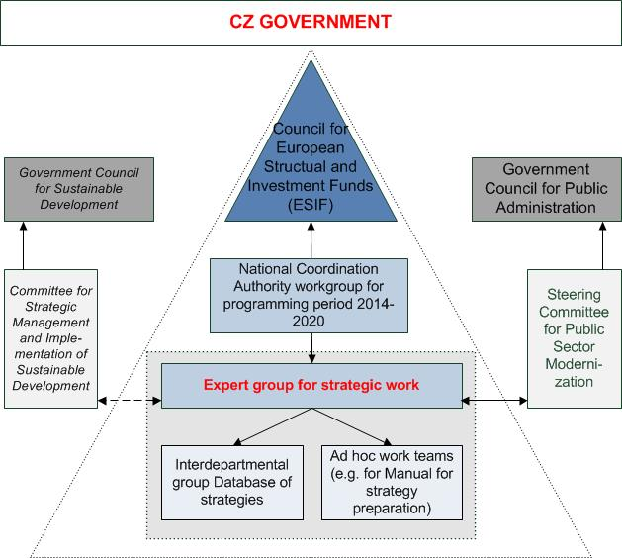
Some key actions
Institutional level – development of strategic management is a part of Strategic development of public administration and its Implementation plans
Notes:
Hierarchies and networks

Slide 16
Some key actions
Acting at EU level:
Ministry of Regional Development is chairing the European Social Fund Transnational Network on Public Governance and Administration
And we build on results of previous international cooperation
Notes:
Reference na Sourcebook:
Problems of complexity
Accountability
Strategic management…

Slide 17
Some key actions
National strategy – creation of a long-term CZ strategy which should include national priorities and development of CZ until (intensive collaboration with the government office)
Strategic maps (of ministries, regions)
Enable to understand the necessity of hierarchy of documents (legislative and strategic) in the office.
Unique complex view on the portfolio od strategies in concrete ministry/region; demonstrate line of effect between legislation and strategy (action plan).
Enables identification of connections among strategies, creation of specific analysis, creation of strategic documents, and such.
Easier orientation for politicians, officers, strategists, implementers and public in a great range of documents.

Slide 18
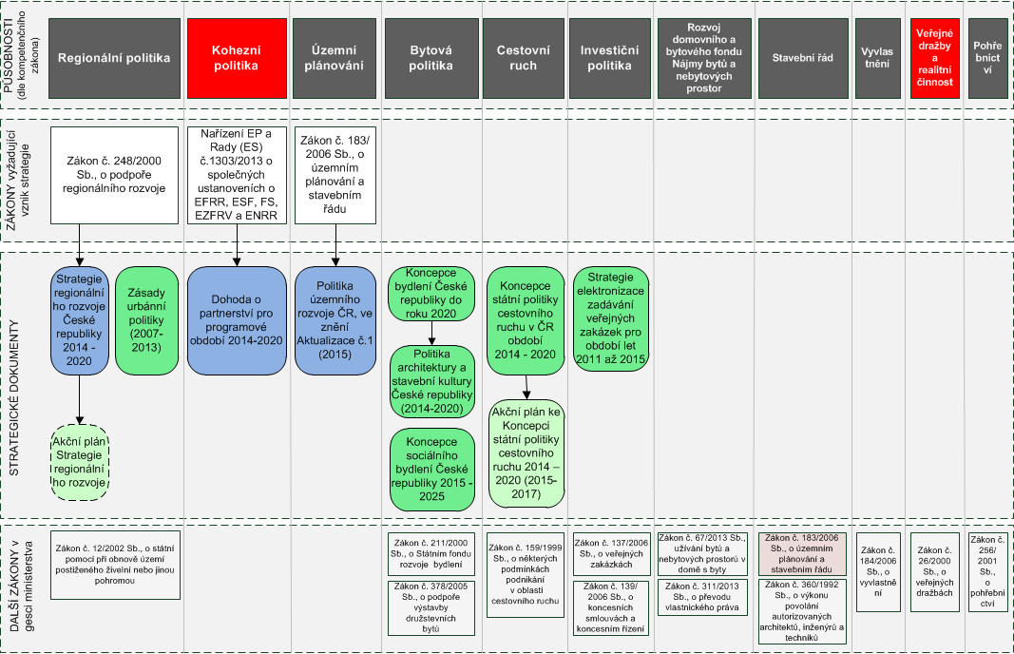

Slide 19
Thank you for your attention!
Vladimír Kváča, Director of the Partnership Agreement, Evaluation and Strategies Department (Ministry of Regional Development of the Czech Republic)

