Slide 1
JEREMIE Initiative in Bulgaria
OP “Competitiveness” 2007-2013”
Praha
26-27 January, 2016
Ministry of Economy
European Regional Development Fund
EUROPEAN UNION
Investing in your future
Operational programme
„Development of the competitiveness
of the Bulgarian economy“ 2007-2013

Slide 2
CONTENT
Main steps
Structure of implementation
Basic information
Financial Engineering Instruments
Results and restraints
Financial Instruments in 2014-2020 programming period
European Regional Development Fund
EUROPEAN UNION
Investing in your future
Operational programme
„Development of the competitiveness
of the Bulgarian economy“ 2007-2013

Slide 3
Main STEPS and TIMELINE
2007 MoU signed for the launch of JEREMIE Initiative between EIF and the Ministry of Economy and Energy, gap analysis was prepared and OP Competitiveness was approved
2009 after long negotiation process the first Funding agreement for the implementation of the JEREMIE Initiative was signed between EIF and the Government represented by MoEE with initial budget of 199 MEUR
2010 first amendment of the Agreements with the EIF and effective start of the implementation
2010 - 4 out of 7 Calls for expression of Interest for implementation launched
2011 first operational agreements with selected FIs signed
2012 second amendment of the Agreements with EIF signed for increase of JEREMIE Initiative budget with 150 MEUR (up to total 349 MEUR)
2012 Funds began to reach more widely to SMEs
European Regional Development Fund
EUROPEAN UNION
Investing in your future
Operational programme
„Development of the competitiveness
of the Bulgarian economy“ 2007-2013

Slide 4
CONTENT
Main steps
Structure of implementation
Basic information
Financial Engineering instruments
Results and restraints
Financial Instruments in 2014-2020 programming period
European Regional Development Fund
EUROPEAN UNION
Investing in your future
Operational programme
„Development of the competitiveness
of the Bulgarian economy“ 2007-2013

Slide 5
Structure of Implementation
Managing Authority –
Ministry of Economy and Energy
Operational Programme “Competitiveness” 2007 - 2013
EUR 349 M
JEREMIE Holding Fund (SPV)
Investment Board
FI 1
FI 2
SMEs
European Regional Development Fund
EUROPEAN UNION
Investing in your future
Operational programme
„Development of the competitiveness
of the Bulgarian economy“ 2007-2013

Slide 6
CONTENT
Main steps
Structure of implementation
Basic information
Financial Engineering instruments
Results and restraints
Financial Instruments in 2014-2020 programming period
European Regional Development Fund
EUROPEAN UNION
Investing in your future
Operational programme
„Development of the competitiveness
of the Bulgarian economy“ 2007-2013

Slide 7
Basic information
Total budget: EUR 349 M( approximately 30 % of OPC resources)
7 Financial Instruments: wide range of debt and equity financial products covering different forms of funding and development stages of the supported enterprises:
On the debt side 2 instruments – portfolio guarantee and portfolio funded risk sharing loans
On the equity side: Risk capital Fund, Growth Fund (terminated), Mezzanine Fund (terminated), Seed and Acceleration Funds and Co-Investment Funds
European Regional Development Fund
EUROPEAN UNION
Investing in your future
Operational programme
„Development of the competitiveness
of the Bulgarian economy“ 2007-2013

Slide 8
CONTENT
Main steps
Structure of implementation
Basic information
Financial Engineering instruments
Results and restraints
Financial Instruments in 2014-2020 programming period
European Regional Development Fund
EUROPEAN UNION
Investing in your future
Operational programme
„Development of the competitiveness
of the Bulgarian economy“ 2007-2013

Slide 9
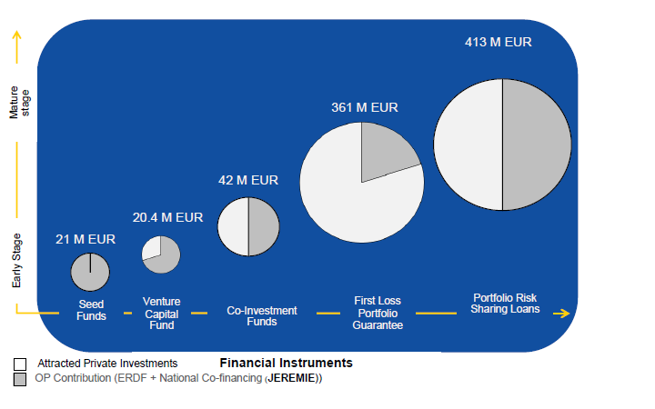
Financial Engineering Instruments
European Regional Development Fund
EUROPEAN UNION
Investing in your future
Operational programme
„Development of the competitiveness
of the Bulgarian economy“ 2007-2013

Slide 10
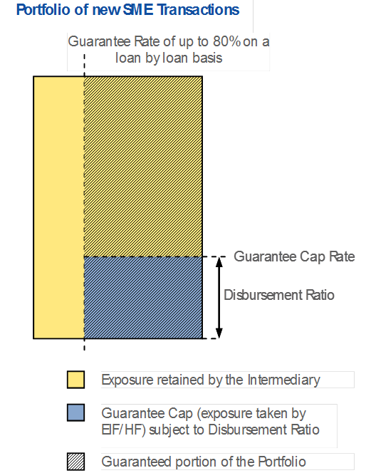
Debt Instruments - First Loss Portfolio Guarantee (FLPG)
Budget: EUR 361M (EUR 72.2M coverage from OP) – 5х leverage.
Guarantee rate of up to 80 % on a loan by loan basis, but capped up to 25 % of the originated portfolio.
Effects for SMEs: reduction of the required collateral, reduction of price and taxes;
Availability period: 2.5 years, starting September 2011.
Operations: investment and/or working capital loans (incl. overdrafts) for SMEs in BGN or EUR with fixed repayment term between 12 – 120 months.
Financial Intermediaries: 5 Banks.
Results: 93 % utilization; 4 951 SME loans for EUR 335M;
European Regional Development Fund
EUROPEAN UNION
Investing in your future
Operational programme
„Development of the competitiveness
of the Bulgarian economy“ 2007-2013

Slide 11
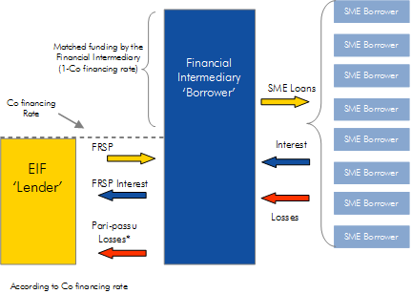
Debt Instruments - Portfolio Risk Sharing Loan (PRSL)
Budget: EUR 413 M (EUR 206.5 M from OP).
Interest rate for the SME: 0% over the JEREMIE part of the loan + market based interest rated over the bank part of the loan => Effective reduction of interest rates of at least 50% to SMEs.
Long-term maturity (up to 10 years).
Availability period: 3 years, Starting end of 2012.
Operations: investment and/or working capital loans for SME in BGN or EUR.
Financial Intermediaries: 7 banks.
Results: 102 % utilization; 3 326 SME supported.
European Regional Development Fund
EUROPEAN UNION
Investing in your future
Operational programme
„Development of the competitiveness
of the Bulgarian economy“ 2007-2013

Slide 12
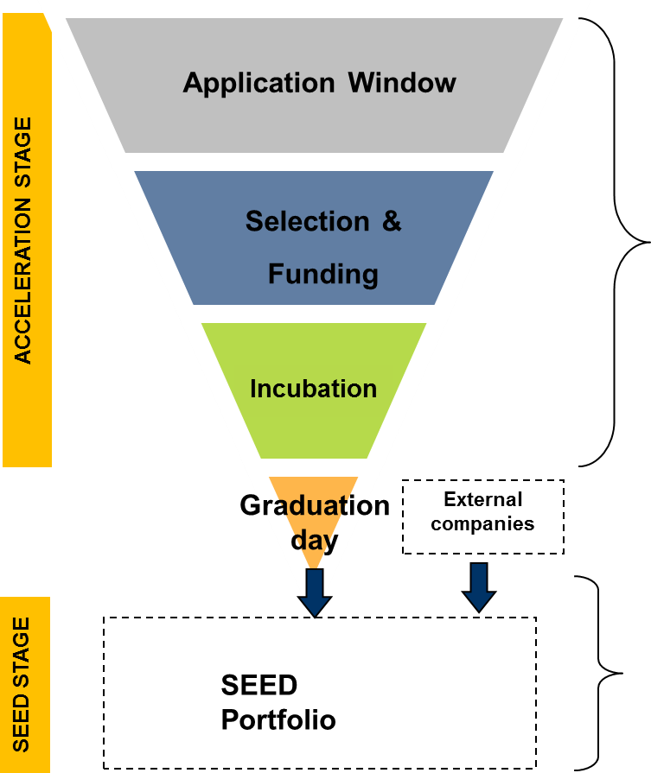
Equity Instruments - Acceleration & Seed Fund
Budget: EUR 21.21 M (EUR 21 M from OP and EUR 0.21 M private financing).
Two stages of investments depending of the development stage of the enterprise.
Investment period: end of 2015, active from September 2012.
Aim: support for innovative start-up businesses trough equity investments up to 200 000 EUR.
Typical acceleration ticket: 25-30 000 EUR.
Entrepreneurs receive advisory services by a pool of mentors.
Financial intermediaries - Eleven and LauncHub;
Results: Over 4 000 business projects evaluated, Investments in 172 innovative start-ups for EUR 17,2 M
European Regional Development Fund
EUROPEAN UNION
Investing in your future
Operational programme
„Development of the competitiveness
of the Bulgarian economy“ 2007-2013

Slide 13
Debt Instruments - Venture capital Fund
JEREMIE Bulgaria EAD
70%
Private Contribution
30%
Budget: EUR 20.4 M (EUR 14.2 M from OP and EUR 6.2 M EUR private financing).
Investment period: end of June 2016.
Ticket size: EUR 0.5m – 1.5m over 12 months period with a cap of EUR 4.5m per SME
Existence of the Fund: 10 + 2 years
Type of Investments: SME in early stage of development and expansion, registered with main place of activity in Bulgaria.
Financial Intermediary - Neveq Capital Partners;
Results: 60% utilization rate, 10 investments.
Risk Capital Fund
EUR 20.4 M
SMEs
European Regional Development Fund
EUROPEAN UNION
Investing in your future
Operational programme
„Development of the competitiveness
of the Bulgarian economy“ 2007-2013

Slide 14
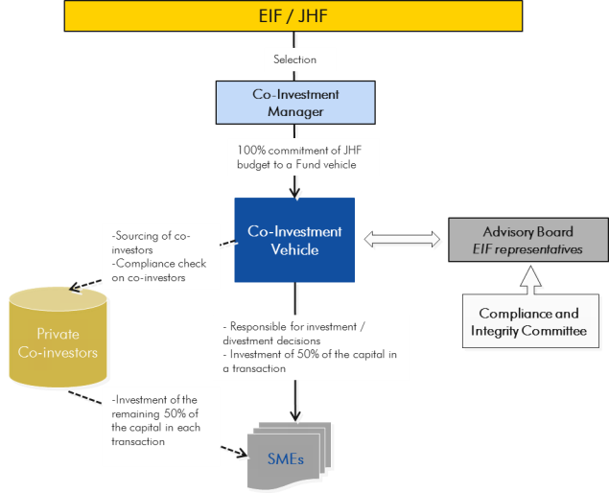
Equity Instruments – Co-Investment Funds
Funding EUR 42 M (EUR 21 M from OP and EUR 21 M private investments).
Matching private investment (50 %) at the level of the SME
Investment Period: end of 2015.
Type of Investments: equity investment for expansion of SMEs and mid-caps
Financial Intermediaries: Empower Capital and Black Peak capital
Results: 100% utilization rate, 13 investments
European Regional Development Fund
EUROPEAN UNION
Investing in your future
Operational programme
„Development of the competitiveness
of the Bulgarian economy“ 2007-2013

Slide 15
CONTENT
Main steps
Structure of implementation
Basic information
Financial Engineering instruments
Results and restraints
Financial Instruments in 2014-2020 programming period
European Regional Development Fund
EUROPEAN UNION
Investing in your future
Operational programme
„Development of the competitiveness
of the Bulgarian economy“ 2007-2013

Slide 16
Results
EUR 828 M extended to SMEs for 4Y (out of EUR 857 M)
2.54 leverage of public funds
8 277 SMEs beneficiaries of Debt instruments
195 SMEs beneficiaries of Equity instruments
5 financial instruments introduced for first time in Bulgaria
17 active operations: 12 banks and 5 privet funds
In 2014 Sofia is among top 3 startups investment destination in Europe
European Regional Development Fund
EUROPEAN UNION
Investing in your future
Operational programme
„Development of the competitiveness
of the Bulgarian economy“ 2007-2013

Slide 17
Results
JEREMIE Initiative allowed banks to undertake more risks in loan origination, especially for working capital
Guarantees aimed reduction of the collateral that is required from the beneficiaries from standard 120% of the loan to 48%
Funded product brought significant reduction of the average interest rate of the portfolio (according to EIF data to 4% for the portfolio compared to above 8% prevailing market rate in Bulgaria)
European Regional Development Fund
EUROPEAN UNION
Investing in your future
Operational programme
„Development of the competitiveness
of the Bulgarian economy“ 2007-2013

Slide 18
Restraints
Difficulties due to Bulgaria’s insufficient experience in this type of operations, as well as lacking or unclear national and European regulatory framework;
Grants are still the preferred option for support by entrepreneurs.
Among financial instruments loans and guarantees are easer deployed than equity investments;
Experts of EIF demonstrate professionalism and compliance with the rules of management public funds but at the same time it was identified insufficient transfer of know-how to ensure the necessary continuity.
European Regional Development Fund
EUROPEAN UNION
Investing in your future
Operational programme
„Development of the competitiveness
of the Bulgarian economy“ 2007-2013

Slide 19
CONTENT
Main steps
Structure of implementation
Basic information
Financial Engineering instruments
Results and restraints
Financial Instruments in 2014-2020 programming period
European Regional Development Fund
EUROPEAN UNION
Investing in your future
Operational programme
„Development of the competitiveness
of the Bulgarian economy“ 2007-2013

Slide 20
Financial Instruments in 2014-2020 programming period
Minister of Finance became coordinator of national policy on the implementation of financial engineering instruments in multiannual financial framework 2014 - 2020 of the European Union.
Increased resources for financial instruments.
Legal analysis of the requirements of both European and national legislation regarding possible forms and structure of management of financial instruments for the 2014-2020 programming period.
European Regional Development Fund
EUROPEAN UNION
Investing in your future
Operational programme
„Development of the competitiveness
of the Bulgarian economy“ 2007-2013

Slide 21
Financial Instruments in 2014-2020 programming period
Fund of Funds
(EUR 657.2M)
“Fund Manager of Financial Instruments in Bulgaria” (SPV)
OP Regional Development
(EUR 253.8M )
OP Innovation and Competitiveness
(EUR 235M)
OP Environment
(EUR 148.4M)
OP Human Resources Development
(EUR 20M)
European Regional Development Fund
EUROPEAN UNION
Investing in your future
Operational programme
„Development of the competitiveness
of the Bulgarian economy“ 2007-2013

Slide 22
Financial Instruments in 2014-2020 programming period
Advantages of the proposed approach
economies of scale;
sustainability in the management of financial instruments;
centralized expertise at national level;
coherence/synergy in the implementation of measures for each group of beneficiaries.
European Regional Development Fund
EUROPEAN UNION
Investing in your future
Operational programme
„Development of the competitiveness
of the Bulgarian economy“ 2007-2013

Slide 23
“Fund Manager of Financial Instruments in Bulgaria” (SPV)
MoU for Technical support with:
World Bank;
EIB;
EBRD;
Responsibilities:
support in preparation of procedural rules, organizational structure, plan for recruitment, monitoring procedures and reporting;
investment strategy;
financing agreements between the managing authorities and the Fund Manager of the Funds;
information system
European Regional Development Fund
EUROPEAN UNION
Investing in your future
Operational programme
„Development of the competitiveness
of the Bulgarian economy“ 2007-2013

Slide 24
Financial Instruments in 2014-2020 programming period
Financial resources for SMEs
Fund of Funds (EUR 235 M)
“Fund Manager of Financial Instruments in Bulgaria” (SPV)
Recycled Fund from JEREMIE (about EUR 50 M per Y)
JEREMIE Holding Fund (SPV) managed by EIF
EIF
SME Initiatives (EUR 102 M)
European Regional Development Fund
EUROPEAN UNION
Investing in your future
Operational programme
„Development of the competitiveness
of the Bulgarian economy“ 2007-2013

Slide 25
Challenges for new programming period
Coordination of all available funds and grants to SMEs
Action plan for implementation of financial engineering instruments
Reduced time funds to reach SMEs
Further simplification is needed
The partnership between all the key stakeholders is of key importance
Publicity measures toward entrepreneurs
Further strength of startup ecosystem
European Regional Development Fund
EUROPEAN UNION
Investing in your future
Operational programme
„Development of the competitiveness
of the Bulgarian economy“ 2007-2013

Slide 26
THANK YOU FOR THE ATTENTION!

